Slide 1
Compiler Construction
Rinus Plasmeijer
Markus Klinik
-
February 2017

Slide 2
Compilers
What is a compiler ?
A program that translates text written in one language (source code) into text written in another language (target code or object code).
General purpose language (C, Haskell), Domain specific (HTML), standard exchange formats (JSON)
The translation is done for some reason:
Source code in a high level language => Easy to read, program, maintain, to reason about…
Target code in machine language => Can be executed by a computer
Transformation needed to some common standard e.g. for information exchange
What is an interpreter ?
A program that translates a program written in one language (source code) into another language (target code or object code) while it also can produce the results by evaluating (interpreting) the target code.
Most issues are applicable for both compilers as well as interpreters
Generating code for modern hardware (cash, multi-core) is commonly much harder than generating code for an interpreter.
It is much easier to debug an interpreter than an executable.
Compiled code is commonly one order of magnitude faster than interpreted code.

Slide 3
Why study Compiler Construction ?
Isn't it a solved problem?
Machines are constantly changing
one core ⇒ multi-core
Speed (Intel) versus Space / Energy consumption (ARM, THUMB, THUMB-2)
Changes in computer architectures force changes in compilers
New languages (dependently typed)
New language constructs (type constructs, generic programming)
Domain specific languages getting popular
New languages / language features pose new compilation techniques
New way of working (browser/tablet/mobile phone/gadgets/IoT instead of desktop)
Old solutions need re-engineering

Slide 4
Intrinsic Merit
Programming languages have a big impact on how computers are used
huge difference between high level language ⇔ low level machine instructions
Declarative : What should be done ⇔ How to realize it
Compiler construction is challenging and fun
many complex compilation steps
interesting conversion and analysis problems
primary responsibility for performance
new architectures, new languages ⇒ new challenges
real results
Knowledge not only useful for making compilers: many applications (also) convert a source language to a target language
Compiler construction poses some of the most interesting problems in computing

Slide 5
Experience
You have used several compilers
What qualities are important in a compiler?
1. Correct code
2. Generated application runs fast
3. Compiler runs fast
4. Compile time proportional to program size
5. Support for separate compilation
6. Good diagnostics for syntax errors
7. Works well with a debugger
8. Precise and flexible type system preventing run-time errors
9. Cross language calls
10. Consistent, predictable optimization
11. …

Slide 6
Abstract view
Big step up from higher level languages – machine code
recognize legal (and illegal) programs
produce understandable error messages
generate correct code
manage storage of all data and code

Slide 7
Traditional two pass compiler
Compilation can be very complex: split the problem up in manageable steps
Two pass compiler:
intermediate representation (IR), commonly a tree structure, machine independent
front end maps code onto IR
allows static analysis (syntactic checks, semantic checks) on the IR
back end maps IR onto concrete target machine
simplify retargeting to another target machine
allows multiple front ends
trade off: more passes ⇒ easier to understand and maintain ⇒ increased compilation time

Slide 8
Question
Can we build n x m compilers with n + m components?
One IR for all languages and all machine architectures
must represent all the features of all languages in one IR
must handle all the features in each back end
Practice: this only works for languages which are semantically closely related…

Slide 9
Front end
Responsibilities:
recognize sentences of the source language
report errors
produce IR
Much of front end construction can be automated
given the grammar of the source language

Slide 10
Front end
a key issue is speed ⇒ use a scanner or tokenizer
Scanner or tokenizer :
maps characters into tokens – the basic units in the syntax
x = x + y;
becomes
<id,x> = <id, x> + <id, y> ;
character string value for a token is a lexeme
typical tokens: number, id, +, -, *, /, do, end ,
eliminates white space (tabs, blanks, comments, lay-out)

Slide 11
Front end
Parser:
recognize context-free syntax
performs context-sensitive analysis
construct IR(s)
produce meaningful error messages
performs error correction where possible to check as much as possible
Parser generators mechanize much of the work

Slide 12
Front end
Context-free syntax is specified with a grammar
<list> ::= nil
| cons <elem> <list>
The format is called Backus-Naur form (BNF)
Formally, a grammar G = (S,N,T,P)
S is the start symbol
N is a set of non-terminal symbols
T is a set of terminal symbols
P is a set of productions or rewrite rules (P : N → N ∪ T)

Slide 13
Front end
Context free syntax can be put to better use
1 <goal> ::= <expr >
2 <expr> ::= <expr> <op> <term>
3 | <term>
4 <term> ::= number
5 | id
6 <op> ::= +
7 | -
This grammar defines simple expressions with addition and subtraction
over the tokens id and number
S = <goal>
T = number, id, +, -
N = <goal> , <expr> , <term> , <op>
P = 1, 2, 3, 4, 5, 6, 7

Slide 14
Front end
Given a grammar, valid sentences can be derived by repeated substitution.
Rule used: Result
<goal> ::= <expr >
<expr> ::= <expr> <op> <term>
| <term>
<term> ::= number
| id
<op> ::= +
| -
1 <goal>
2 <expr >
5 <expr> <op> <term>
7 <expr> <op> id(y)
2 <expr> - y
4 <expr> <op> <term> - y
6 <expr> <op> number(2) - y
3 <expr> + 2 - y
5 <term> + 2 - y
x + 2 - y
To recognize a valid sentence in some Context Free Grammar, we reverse this process and build up a parse

Slide 15
Front end
A parse can be represented by a tree called a parse tree or syntax tree
Obviously, this contains a lot of unnecessary information

Slide 16
Front end
So, compilers often use an abstract syntax tree
This is much more concise .
Abstract Syntax Trees (ASTs) are often used as an IR between front end and back end.

Slide 17
Back end
Responsibilities
translate IR into target machine code
choose instructions for each IR operation
decide what to keep in registers at each point
ensure conformance with system interfaces
Automation has been less successful here

Slide 18
Back end
Instruction selection:
produce compact, fast code
use available addressing modes of the machine
Uses memory for stack(s) to handle functions calls and heap(s) to store global data
Special memory: registers – fastest access, but there are only few (8-16-32)

Slide 19
Back end
Register Allocation:
when a memory location is often used, use a register as memory location
Registers are limited: move content from stack or heap to a register and back
Effects instruction choices
Effects movements of data, efficiency of the implementation
optimal allocation is difficult

Slide 20
Traditional three pass compiler
Code Improvement
analyzes and changes IR
goal is to optimize time and space behavior at runtime
must preserve meaning

Slide 21
Optimizer (middle end)
Modern optimizers are usually built as a set of passes
Typical passes:
semantic analysis
static analysis (e.g. typing, data flow analysis, control flow analysis)
constant propagation and folding
common sub-expression elimination
redundant store elimination
dead code elimination

Slide 22
Compiler example

Slide 23
Compiler phases
Phase | Action
Lex | Break source file into individual words, or tokens
Parse | Analyze the phrase structure of program
Semantic Actions | Build a piece of abstract syntax tree for each phrase
Semantic Analysis | Determine what each phrase means, relate uses of variables to their definitions, check types of expressions, request translation of each phrase
Frame Layout | Place variables, function parameters, etc., into activation records (stack frames) in a machine-independent way
Translate | Produce intermediate representation trees (IR trees), a notation that is not tied to any particular source language or target machine
Canonicalize | Hoist side effects out of expressions, and clean up conditional branches, for convenience of later phases
Instruction Selection | Group IR-tree nodes into clumps that correspond to actions of target machine instructions
Control Flow Analysis | Analyze sequence of instructions into control flow graph showing all possible flows of control program might follow when it runs
Data Flow Analysis | Gather information about flow of data through variables of program; e.g., liveness analysis calculates places where each variable holds a still needed (live) value
Register Allocation | Choose registers for variables and temporary values; variables not simultaneously live can share same register
Code Emission | Replace temporary names in each machine instruction with registers

Slide 24
In this course
You build compiler for the SL programming language (Simple Language)
The compiler is a three-pass compiler
The back-end is a SSM machine code simulator (Simple Stack Machine)
Interfaces (grammar, IR, type rules, target machine) are provided by us
Your passes must pass
Advanced topic for investigation; presentation, implementation not required
Oral exam if all pass
Deadlines
9-3-2017 Presentation + Report Pass 1: Parsers
13-4-2017 Presentation + Report Pass 2: Analysis & Typing
11-5-2017 Presentation + Report Pass 3: Standard Compiler for SSM
8-6-2017 Final Presentation + Final Report : Extended Compiler
15-6-2017 Oral Exams

Slide 25
Grammar SPL
SPL = Decl+
Decl = VarDecl
| FunDecl
VarDecl = ('var' | Type) id '=' Exp ';'
FunDecl = id '(' [ FArgs ] ')' [ '::' FunType ] '{' VarDecl* Stmt+ '}'
RetType = Type
| 'Void'
FunType = [ FTypes ] '->' RetType
FTypes = Type [ FTypes ]
Type = BasicType
| '(' Type ',' Type ')'
| '[' Type ']'
| id
BasicType = 'Int'
| 'Bool'
| 'Char'
FArgs = [ FArgs ',' ] id
Stmt = 'if' '(' Exp ')' '{' Stmt* '}' [ 'else' '{' Stmt* '}' ]
| 'while' '(' Exp ')' '{' Stmt* '}'
| id Field '=' Exp ';'
| FunCall ';'
| 'return' [ Exp ] ';'

Slide 26
Grammar SPL
Exp = id Field
| Exp Op2 Exp
| Op1 Exp
| int
| char
| 'False' | 'True'
| '(' Exp ')'
| FunCall
| '[]'
| '(' Exp ',' Exp ')'
Field = [ Field ( '.' 'hd' | '.' 'tl' | '.' 'fst' | '.' 'snd' ) ]
FunCall = id '(' [ ActArgs ] ')'
ActArgs = Exp [ ',' ActArgs ]
Op2 = '+' | '-' | '*' | '/' | '%'
| '==' | '<' | '>' | '<=' | '>=' | '!='
| '&&' | '||'
| ':'
Op1 = '!' | '-'
int = [ '-' ] digit+
id = alpha ( '_' | alphaNum)*

Slide 27
Example SL
facR ( n ) :: Int -> Int
{ if ( n < 2 ) {
return 1;
} else {
return n * facR ( n - 1 );
}
}

Slide 28
Example SL
facI ( n ) :: Int -> Int
{ var r = 1;
while ( n > 1 )
{ r = r * n;
n = n - 1;
}
return r;
}

Slide 29
Example SL
product ( list ) :: [Int] -> Int
{ if ( isEmpty ( list )) {
return 1;
} else {
return list.hd * product ( list.tl );
}
}

Slide 30
Example SL
fromTo (from, to) :: Int Int -> [Int]
{ if ( from <= to ) {
return from : fromTo ( from + 1, to );
} else {
return [];
}
}

Slide 31
Example SL
reverse ( list ) :: [t] -> [t]
{ var accu = [];
while ( ! isEmpty ( list ))
{ accu = list.hd : accu ;
list = list.tl;
}
return accu ;
}

Slide 32
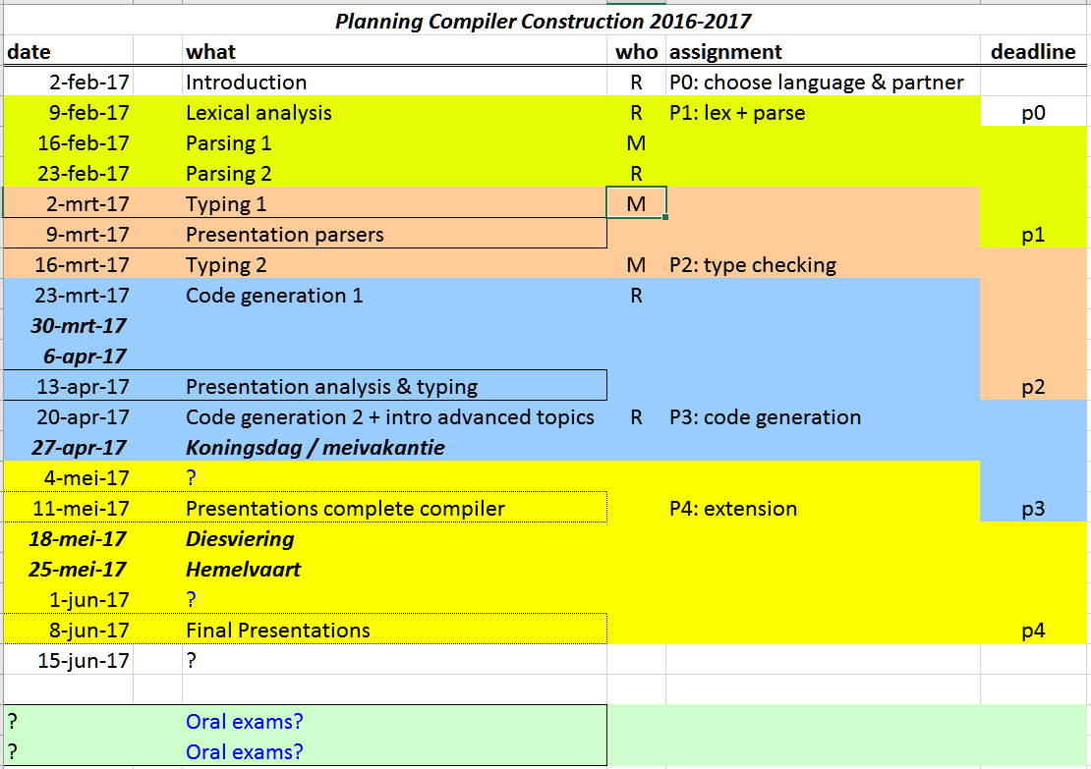
Planning

